Slide 1
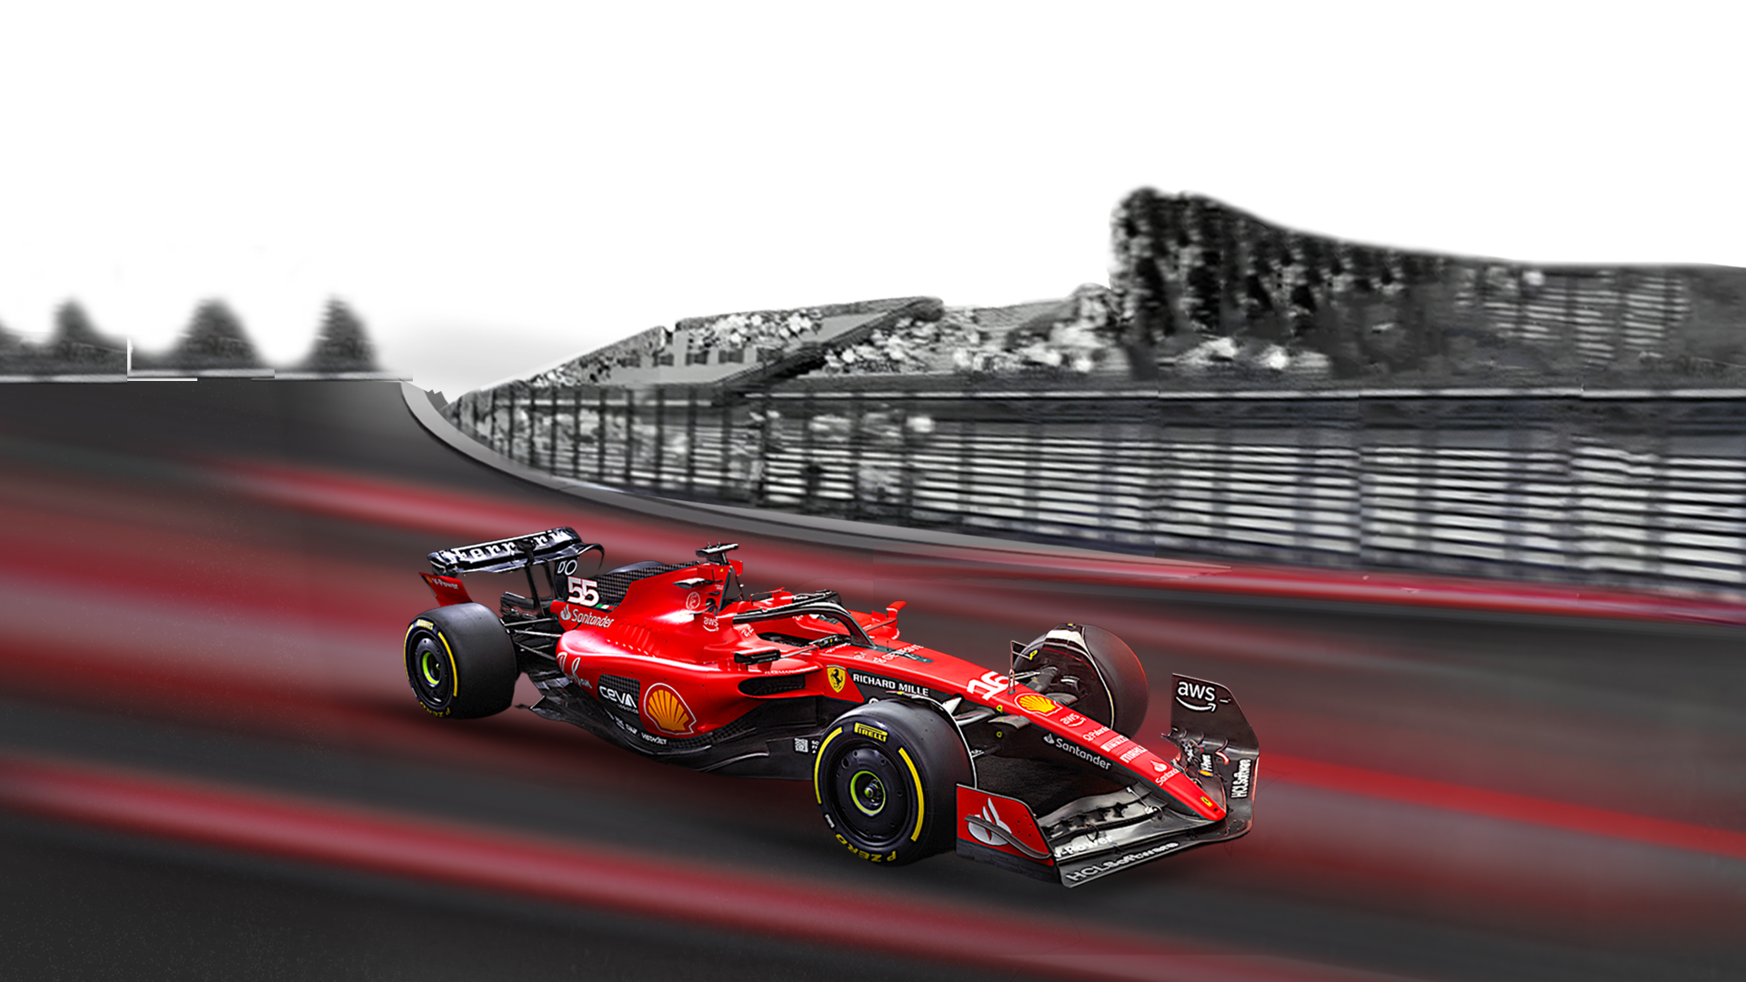
Formula 1
Historical Performance & Market Analysis (1950–2025)
By: Babalola-Smith Mobolarin

Slide 2

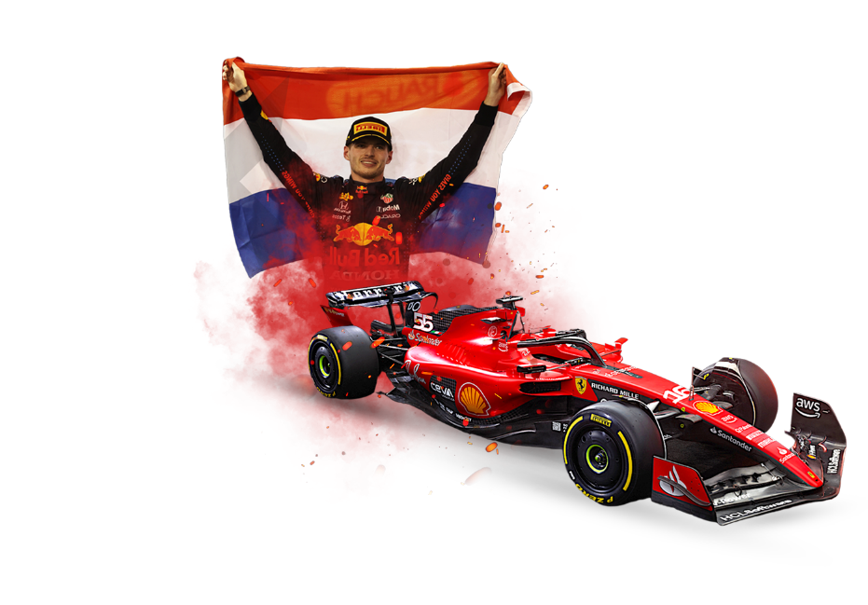
INTRODUCTION
Formula 1 is not just the pinnacle of motorsport; it is a global $2B+ industry, powered by drivers, constructors, sponsors, and media partners. Success on the track drives more than trophies; it creates brand equity, sponsorship value, and long-term investment opportunities. This report provides a strategic analytics review of F1 race history, focusing on patterns of dominance, race evolution, geographic trends, and competitiveness. The goal is to support FIA & Liberty Media in shaping a balanced, engaging sport, while equipping sponsors and investors with insights for maximising visibility and returns.

Slide 3

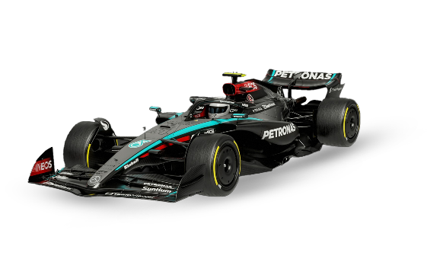
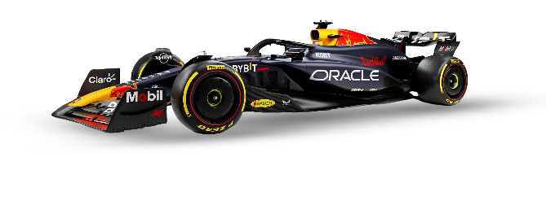
Executive Summary
This report analyses 1,142 Formula 1 races (1950–2025) to identify patterns of dominance, race evolution, competitiveness, and geographic growth. Key findings reveal clear eras of dominance (Schumacher–Ferrari, Hamilton–Mercedes, Verstappen–Red Bull), a trend toward standardized race lengths, and ongoing geographic expansion outside Europe. Recommendations address competitive balance (FIA) and brand visibility opportunities (sponsors

Slide 4
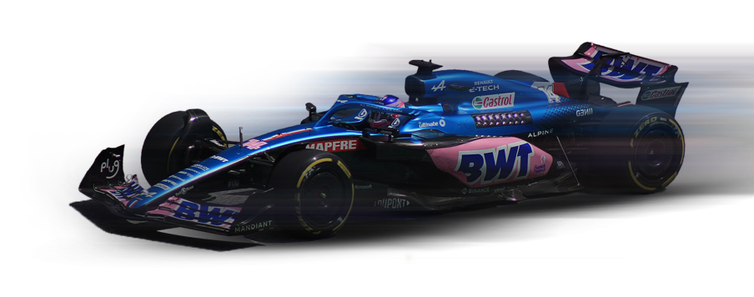
Who is the client?
FIA & Liberty Media (Management): Interested in competitiveness, global expansion, and the sport’s evolution.
Sponsors & Investors: Interested in visibility, dominance, and returns on sponsorship exposure.
INDUSTRY: Motorsport, Media & Entertainment, Automotive Technology.
BUSINESS: Organizing and governing global Formula 1 races. Monetizing through broadcasting rights, sponsorships, and events.

Slide 5


Objectives & Goal Analysis
Top Drivers by Decade
Top Constructors by Decade
Sustained Dominance Across Decades
Race Evolution – Race Length Variety
Decade of Highest Winner Variety
Circuits with Highest Winner Variety
Most Popular Continents & Countries to Race

Slide 6
Problem Statement
F1 Management wants to keep the sport globally competitive and engaging, ensuring that dominance cycles don’t reduce fan interest.
Sponsors & Investors need to know which teams or drivers are consistently dominant across eras to make better endorsement decisions.

Slide 7

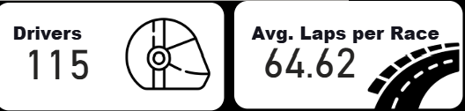
KEY METRICS
o Driver KPI’s: Total wins, wins by decade, win share %
o Constructor KPI’s: Total wins, wins by decade, dominance streaks
o Race KPI’s: Average laps, average race duration, % of short/medium/long races
o Geographic KPI’s: Wins by continent, top winning circuits, diversity of winners by region

Slide 8
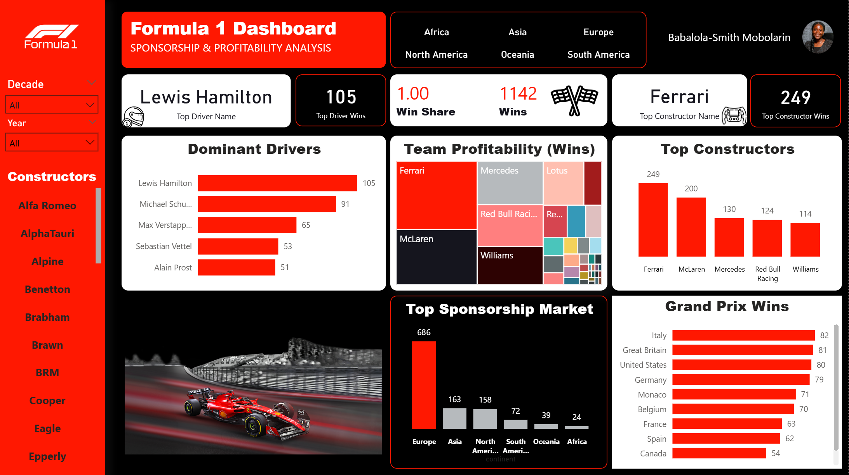

Slide 9
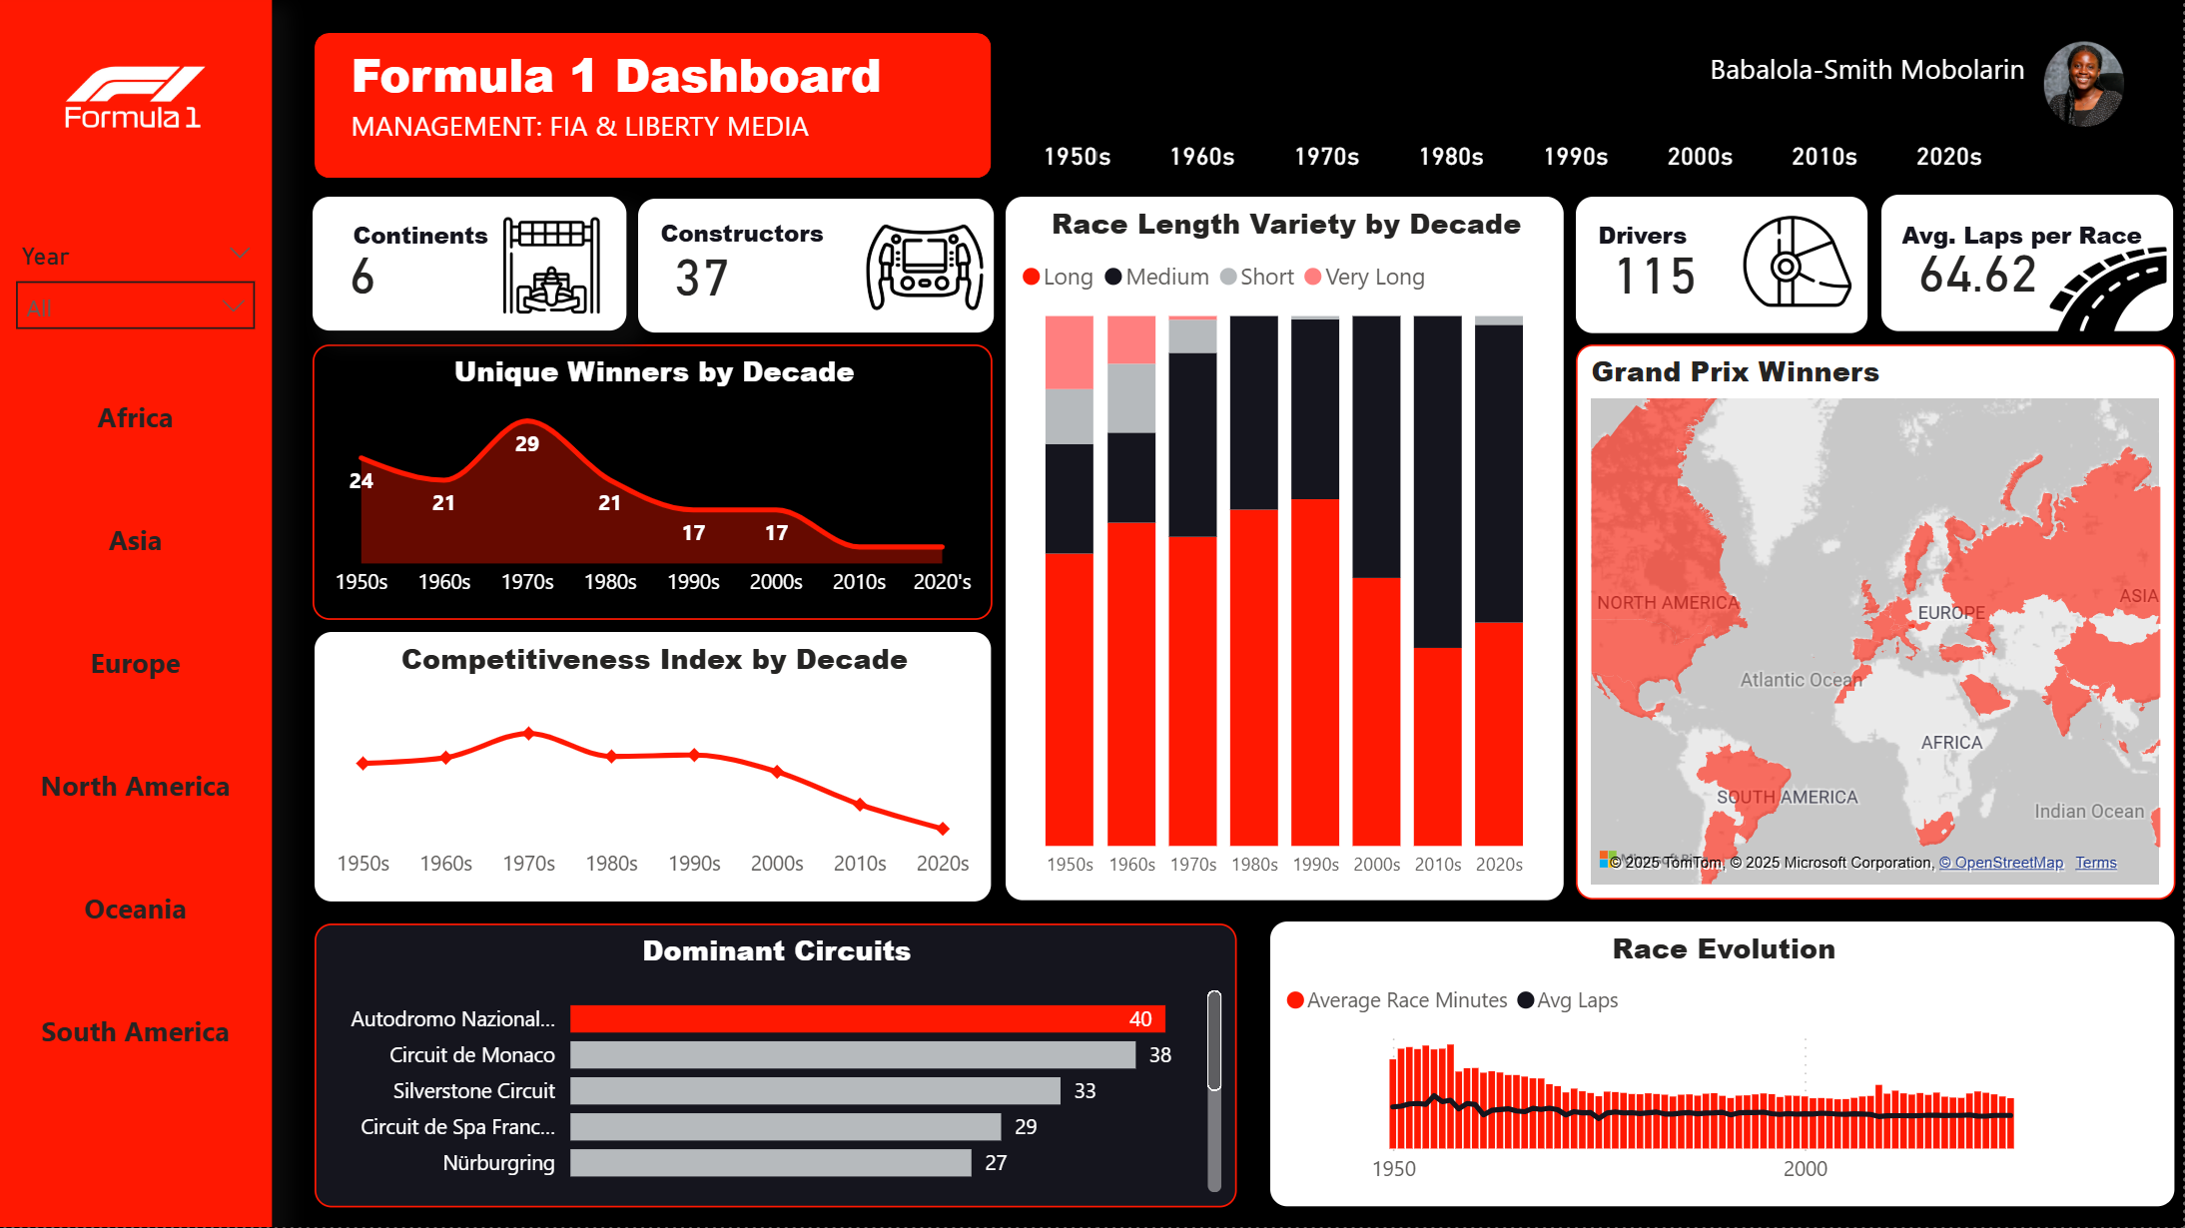

Slide 10
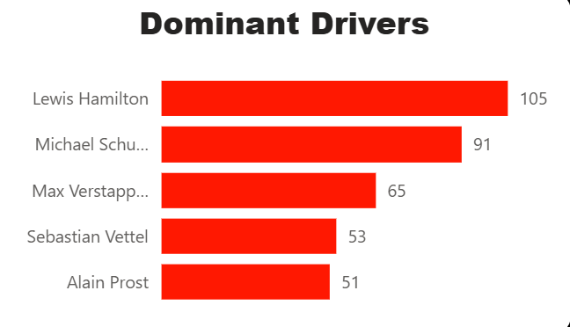
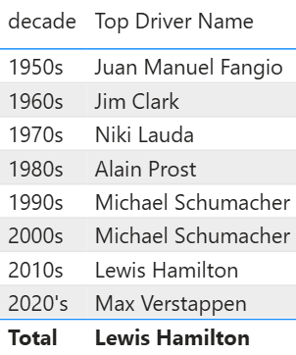
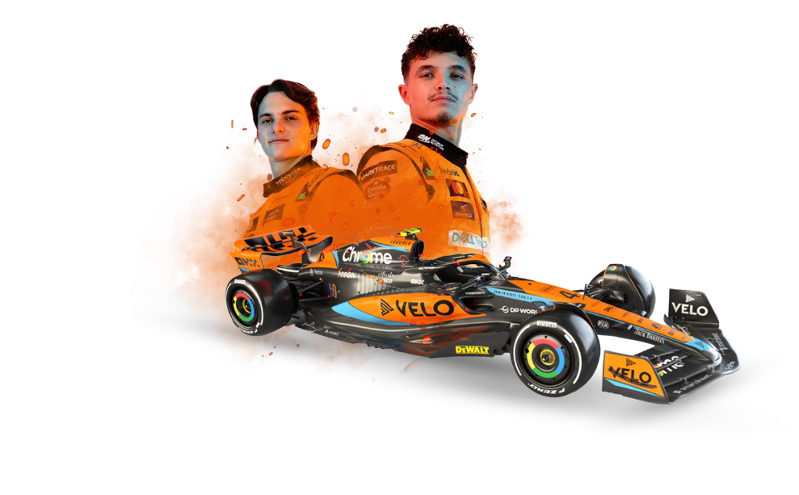
Task 1a: Who are the top drivers in each decade?
FINDINGS: Each decade has been shaped by standout champions: Schumacher dominated the 2000s, Vettel led the early 2010s, and Hamilton sustained dominance through the 2010s into the 2020s..
INSIGHTS: Star drivers create eras (and storylines) that drive audience loyalty and media narratives; however, when a single driver concentrates an outsized share of wins, overall season unpredictability declines..
RECOMMENDATIONS: Sponsors should align with top drivers/constructors of each era. FIA/Liberty can spotlight decade rivalries in storytelling campaigns.
EXPECTED OUTCOMES: Enhanced sponsor ROI, improved fan engagement through historical rivalries.

Slide 11
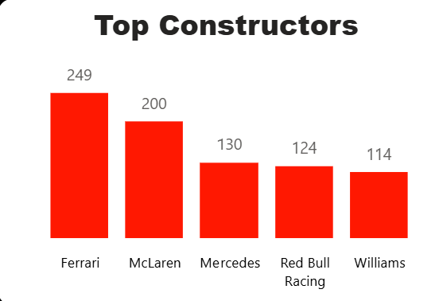
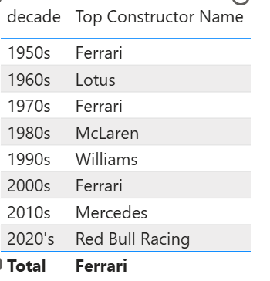
Task 1b: Who are the top constructors in each decade?
FINDINGS: Ferrari defined the 2000s, Red Bull surged in the early 2010s, and Mercedes set new standards of consistency through the 2010s–2020s.
INSIGHTS: Dominance cycles exist as Ferrari (2000s) → Red Bull (2010s) → Mercedes (2010s–2020s). Therefore, sponsorship and visibility cluster around these teams.
RECOMMENDATIONS: FIA should promote regulatory frameworks that encourage closer competition among constructors. Sponsors should strategically partner with dominant teams while keeping flexible branding options to pivot when competitive dynamics shift.

Slide 12
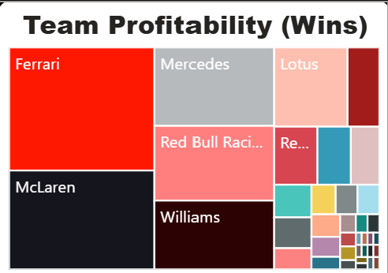
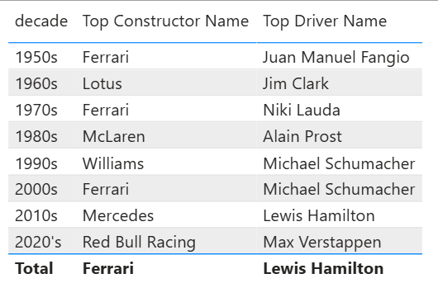
Task 2: Which drivers/constructors sustained dominance across multiple decades?
FINDINGS: Each decade has been shaped by standout champions: Schumacher dominated the 2000s, Vettel led the early 2010s, and Hamilton sustained dominance through the 2010s into the 2020s.
INSIGHTS: Long-term constructor success is a sign of institutional capability; it creates brand value and continuity.
RECOMMENDATIONS:
Monitor long-term concentration metrics.
For legacy brand alignment, Ferrari/McLaren/Mercedes continue to be strong

Slide 13
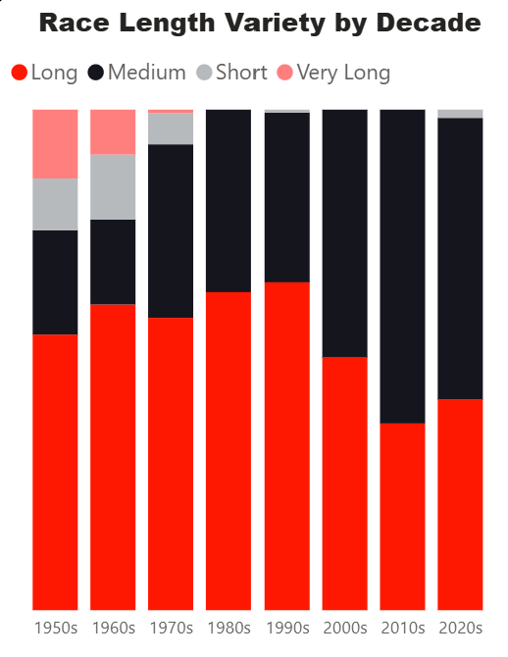
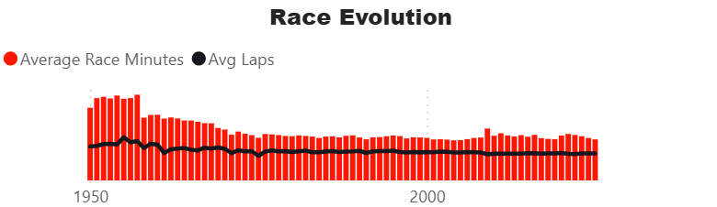
Task 3: How have race lengths changed over time?
FINDINGS: Each decade has been shaped by standout champions: Schumacher dominated the 2000s, Vettel led the early 2010s, and Hamilton sustained dominance through the 2010s into the 2020s..
INSIGHTS: Race design and regulations (distance, time limits, standardized lap lengths) have driven greater predictability.
RECOMMENDATIONS:
Keep a strong baseline standard for race lengths to preserve broadcast reliability

Slide 14
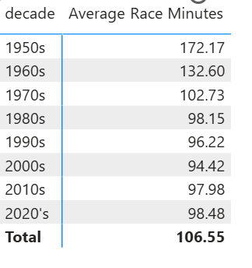
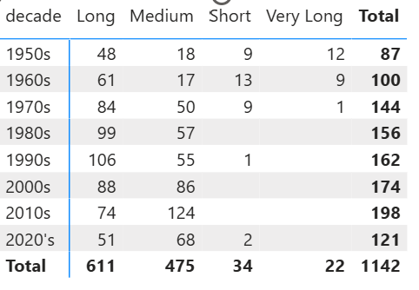
Task 3: How have race lengths changed over time?

Slide 15
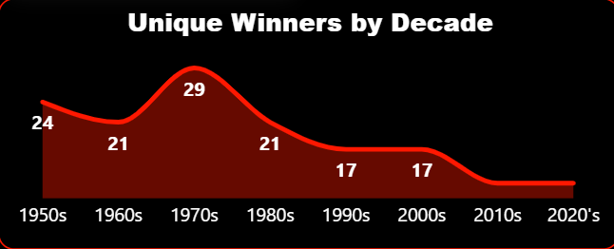
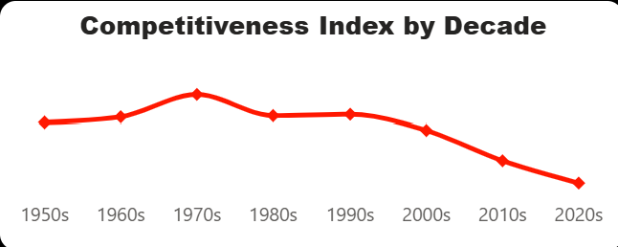
Task 4: Which decade/era had the highest variety of winners?
FINDINGS:
Highest Variety: 1970’s (29)
Lowest Variety: 2010’s (12)
INSIGHTS: Early F1 exhibited high winner variety.
RECOMMENDATIONS: Use the competitiveness index (unique winners / races) as a KPI and signal threshold-based reviews

Slide 16
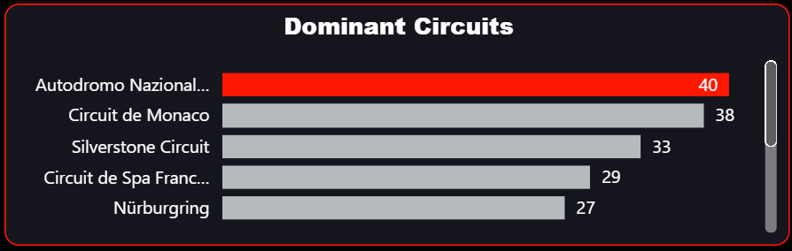
Task 5: Which circuits had the highest variety of winners?
Autodromo Nazionale di Monza: 75 races → 40 unique winners (diversity indicator high).
Circuit de Monaco: 71 races → 38 unique winners.
Silverstone Circuit: 59 races → 33 unique winners.
Circuit de Spa-Francorchamps: 58 races → 29 unique winners.
Nürburgring / Red Bull Ring / Circuit Gilles Villeneuve / Interlagos (Brazil) all show high unique-winner counts relative to races.
INSIGHTS: Longstanding circuits frequently produce a high count of unique winners simply due to many editions.
RECOMMENDATIONS: For fan engagement and broadcast intrigue, continue to promote circuits with high unpredictability as marquee events.

Slide 17
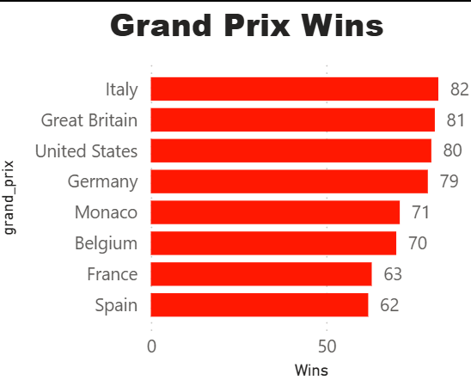
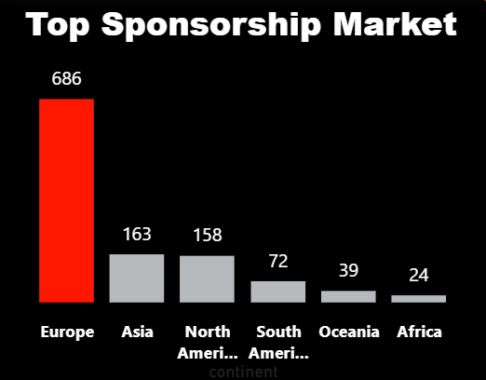
Task 6: Which continents & grand prix are raced the most?
FINDINGS: Each decade has been shaped by standout champions: Schumacher dominated the 2000s, Vettel led the early 2010s, and Hamilton sustained dominance through the 2010s into the 2020s.
INSIGHTS: Europe remains the historic center; however, Asia and the Middle East are clear growth regions since the 2000s and represent commercial expansion opportunities.
RECOMMENDATIONS: Maintain a calendar balance that preserves heritage circuits in Europe while continuing strategic expansion in Asia, Middle East and North America.

Slide 18
Recommendations: FIA/Liberty Media
Operational KPI: Adopt and report a yearly Competitiveness Index.
Calendar strategy: Preserve heritage circuits (Monza, Silverstone, Spa) as marquee events (fan history + high variety), while rotating in new markets (Asia, Middle East) for commercial growth.
Regulation signaling: When major rules shift (engine regs, aero changes), accompany with explicit goals (increase constructor parity by X% in 2 seasons) and measure outcomes.

Slide 19
Recommendations: Sponsors
Sponsor playbook: Sponsors are encouraged to balance investments with a dominant team/driver for predictable visibility while allocating a portion to emerging markets/circuits for growth exposure.

Slide 20

Thank you

